Slide 1

Federal Performance Reporting Guidance
Federal Performance Reporting Guidance
Federal Reporting Program Year: 07/01/2025 - 06/30/2026
Federal Reporting Period: 07/01/2026 - 07/31/2026
INTrainingDWD.org

Slide 2



Federal Reporting Requirements and Reminders
2
Why do we have to report?
“States must report performance information about ETPs to the DOL Employment and Training Administration (ETA) in accordance with WIOA section 116 and regulations at 20 CFR 677.230 and 20 CFR 680.490.
WIOA mandates the collection of specific information for each program of study for each eligible provider of training services under title I Adult and Dislocated Worker programs.
From ETPL Policy: To maintain INTraining or ETPL inclusion, all training providers must complete the annual federal performance reporting. Under WIOA, each state is required to submit student-level data for all training programs to the United States Department of Labor (USDOL) on an annual basis. Student-level data should be reported at the beginning and end of each cohort and must be reported by the July 31st deadline for that reporting period.
TRAINING AND EMPLOYMENT GUIDANCE LETTER WIOA NO. 3-18 OPERATING GUIDANCE for the WORKFORCE INNOVATION AND OPPORTUNITY ACT (referred to as WIOA or the Opportunity Act)

Slide 3
Federal Reporting Requirements and Reminders
3
Federal Reporting Requirements and Reminders
Dates to Know:
The program year for student data reporting begins July 1, 2025, and ends June 30, 2026.
Student data must be submitted during the reporting period beginning July 1, 2026, and ending July 31, 2026.
What Needs Reporting:
All programs on INTraining that require federal reporting (as indicated within the portal) must have a submitted report to be eligible for continued program approval and ETPL placement.
  Apprenticeship programs are not required to report through INTraining – completed through RAPIDS
If a program on INTraining requires federal reporting, but the program did not serve any students during the previous program year, the provider must still report.
Student data is to be reported on any student, regardless of funding source, who enrolls in a training program during the program year.
Failure to Report:
If a provider fails to submit a report on any INTraining program that requires federal reporting by the July 31, 2026, deadline, the program location(s) will be placed in a Pending Data status and will be removed from INTraining/ETPL placement for a minimum of six (6) months.

Slide 4
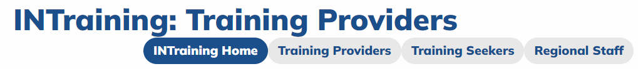
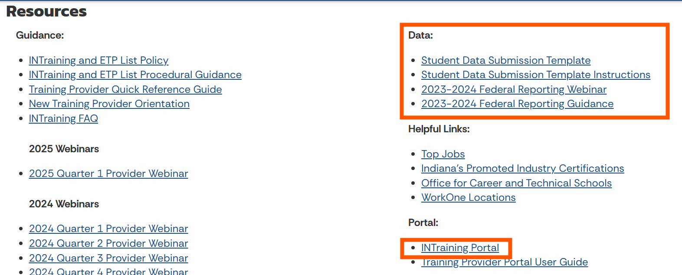
Accessing the Portal and Reporting Resources
4
Accessing the Portal and Reporting Resources
1. Navigate to INTrainingDWD.org , and select the “Training Providers” tab.
2. Scroll toward the bottom to access the portal to login, as well as the ‘Data’ section to retrieve reporting tools and information.

Slide 5
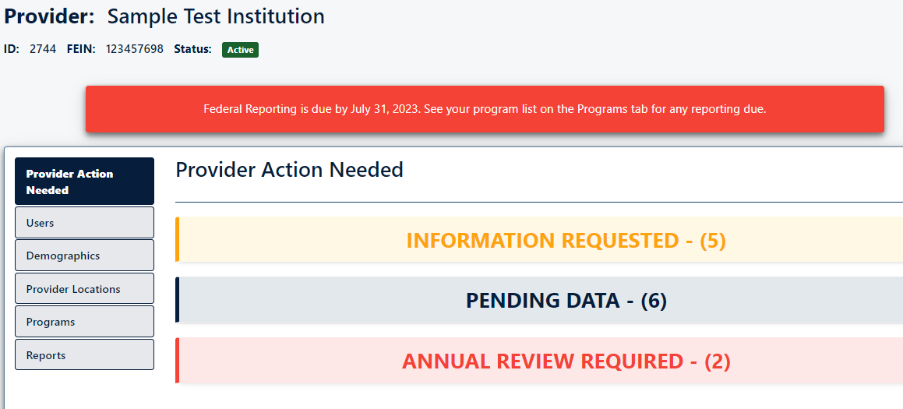
Federal Reporting Requirements and Reminders
5
Federal Reporting Requirements and Reminders
Federal reporting notifications, banners, reports, and submission will be activated and available on INTraining for use during the month of July (the reporting period).

Slide 6
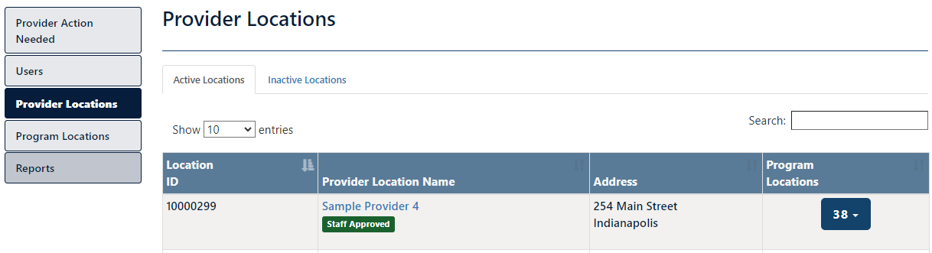
Reporting Terminology to Know
6
Reporting Terminology to Know
Provider Location: This is the approved location where training takes place or is administered (e.g. online only). Providers may have multiple training locations.

Slide 7
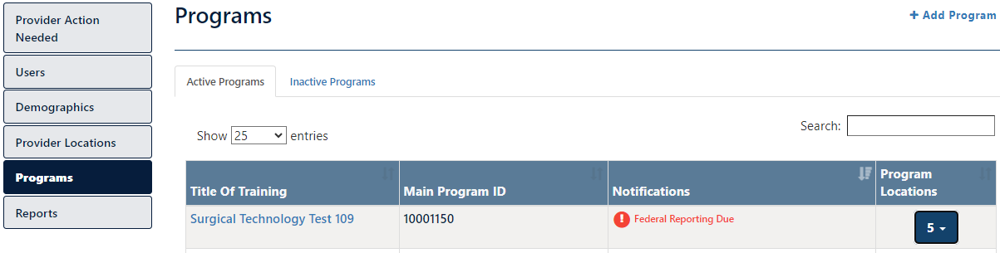
Reporting Terminology to Know
7
Reporting Terminology to Know
Main Program: This is the occupational training program offered by the provider. A main program may be offered at multiple provider locations.

Slide 8
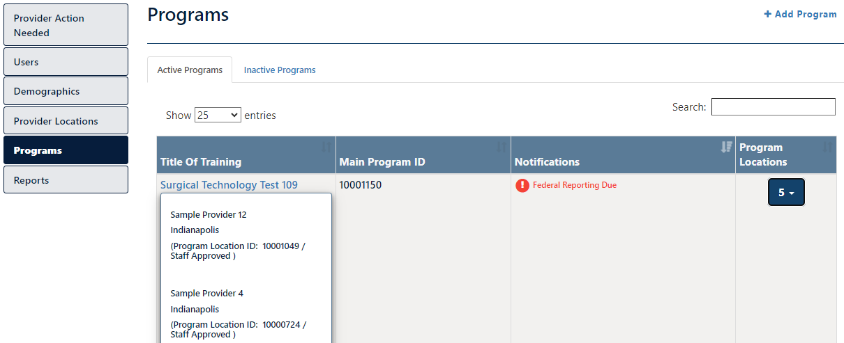

Reporting Terminology to Know
8
Reporting Terminology to Know
Program Location: This is the system-generated number of an approved provider location combined with an approved main program. This is where providers will submit student performance data.
1
2

Slide 9
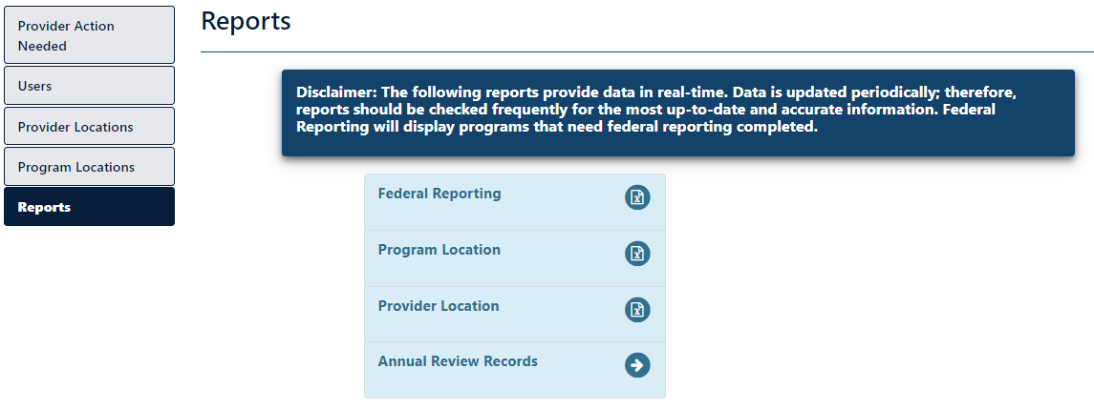
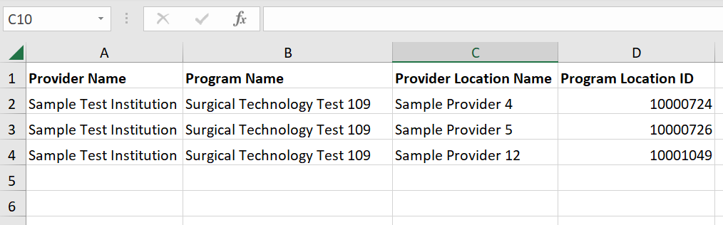
Three Ways to Identify Which Programs Need Reporting - #3
Three Ways to Identify Which Programs Need Reporting
9
1. Providers can export a list of all programs in need of ‘Federal Reporting’, along with each individual program location where you will be uploading student data.
Providers can export this report and to use as a ‘checklist’ to ensure each program location’s reporting is addressed. Once reporting is complete for a particular program location, it will be removed from future exports of this report.
2
1

Slide 10
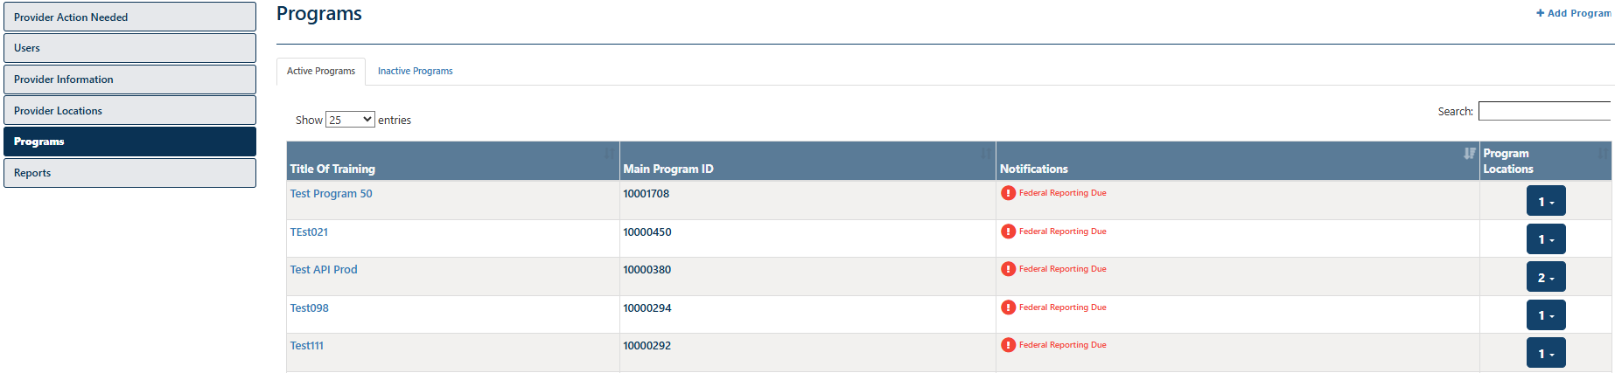
Three Ways to Identify Which Programs Need Reporting - #1
Three Ways to Identify Which Programs Need Reporting
10
2. After accessing the ‘Programs” tab, providers will see a “Federal Reporting Due” notification in red next to each main program that has program locations in need of federal reporting.
Be sure to review both the ‘Active Programs’ list, along with the ‘Inactive Programs’ list. Federal reporting is required for all programs that were active at any time during the prior program year.

Slide 11
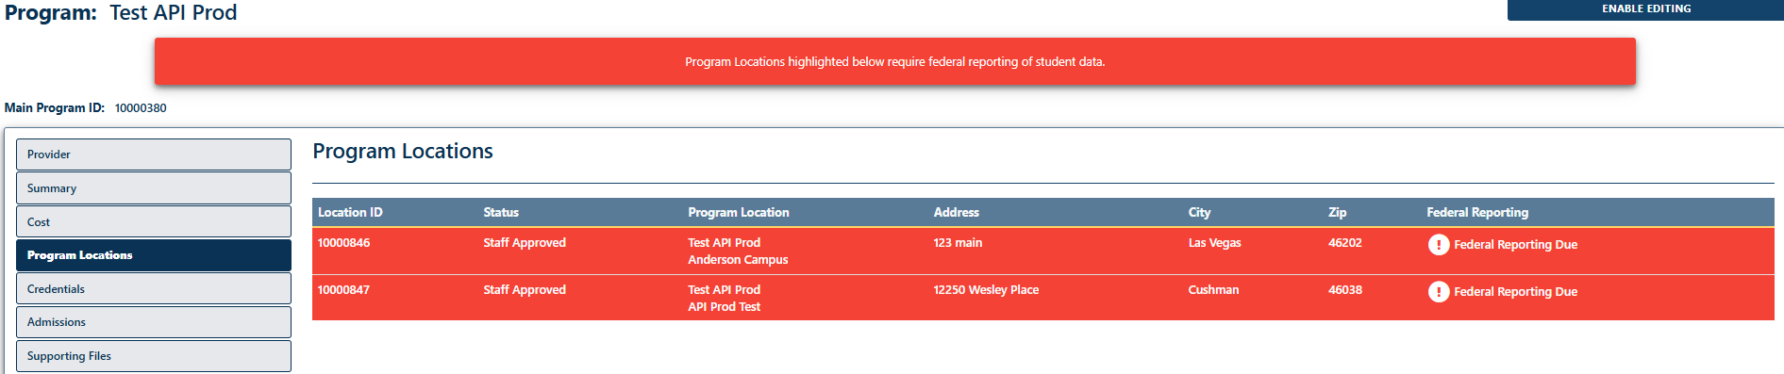
Three Ways to Identify Which Programs Need Reporting - #2
Three Ways to Identify Which Programs Need Reporting
11
3. Program locations are highlighted in red, along with a “Federal Reporting Due” notification.
Under the “Programs” tab, a provider can click one of the program titles navigating the user to the details of the selected main program. From this page, a provider can access the ‘Program Locations’ tab to view which program locations need reporting.

Slide 12
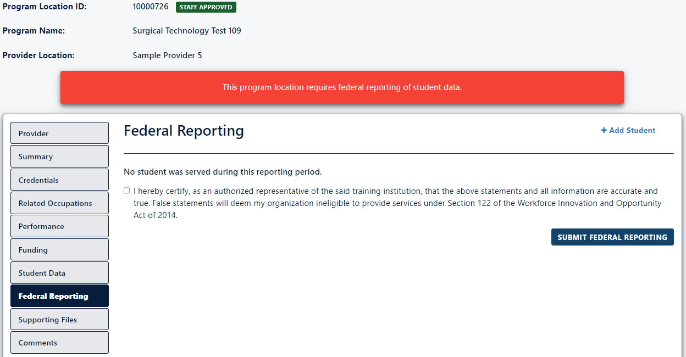
Three Reporting Methods - #1
Three Reporting Methods
12
Method 1: Reporting No Students Served
After the provider has accessed the specific program location page where no students were served, the provider will select the “Federal Reporting” tab. From this tab, the provider will review and check the box certifying that the report is true and accurate, and then click “Submit Federal Reporting”.
2
3
1

Slide 13
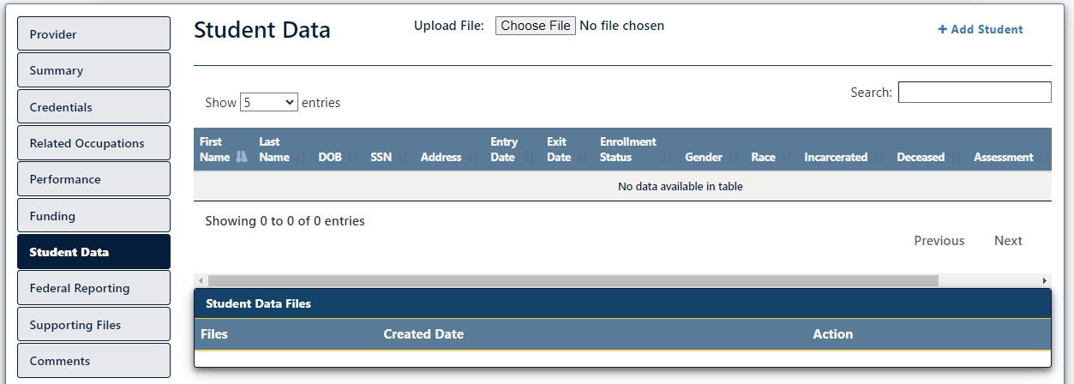
Three Reporting Methods - #2
Three Reporting Methods
13
Method 2: Individual Student Record Entry
After the provider has accessed the specific program location page where a student record needs entering, the provider will select the “Student Data” tab. From this tab, the provider will then click on the “+ Add Student” option to begin entering all required information for an individual participant.
2
1

Slide 14
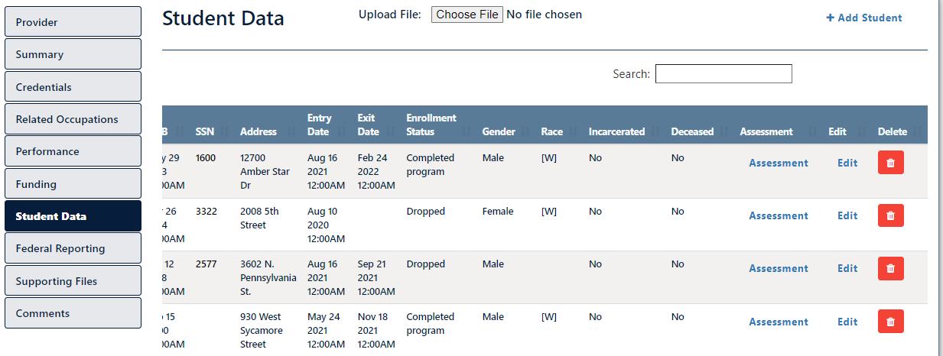
Three Reporting Methods - #2
Three Reporting Methods
14
Method 2: Individual Student Record Entry
After the provider has entered in the student record, the provider will then access the Assessment link to report the credential attainment result for each program participant. (Note: Depending on the size of your screen, this column can be hidden, so be sure to use the scroll bar to the right to view the assessment option)
2
1

Slide 15
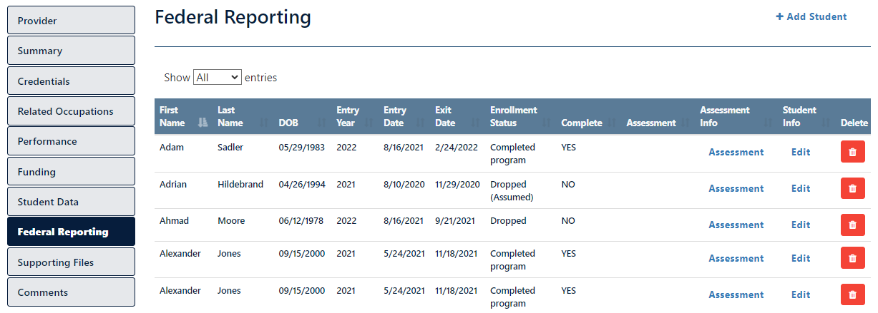
Three Reporting Methods - #2
Three Reporting Methods
15
Method 2: Individual Student Record Entry
After the provider has entered in the student record, including the Assessment results for each participant, the provider can navigate to the “Federal Reporting” tab, to conduct a final review of all submitted records. At the bottom of the tab, the provider will review and check the box certifying that the report is true and accurate, and then click “Submit Federal Reporting”.
Scroll to the bottom to certify and submit the report.

Slide 16
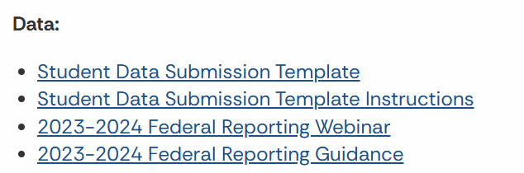
Three Reporting Methods - #3
Three Reporting Methods
16
Method 3: Student File Upload
This method allows for a training provider to retrieve and complete a student data Excel file and upload it within the provider location page for reporting.
To successfully utilize this method, the provider must first navigate to the DWD Training Provider site, download the Student Data Submission Template file linked under the Data section, and access the student data submission instructions. Please CAREFULLY review the instructions and adhere to the included guidelines exactly as written to reduce the risk of the uploaded file not being accepted into the INTraining student data portal.

Slide 17
Three Reporting Methods - #3
Three Reporting Methods
17
Method 3: Student File Upload
Once the provider has completed the first step in this method, the provider will access the specific program location page where the student record file will be uploaded. The provider will first select the “Student Data” tab. From this tab, the provider will then click the “Choose File” option to upload their completed file.
2
1

Slide 18
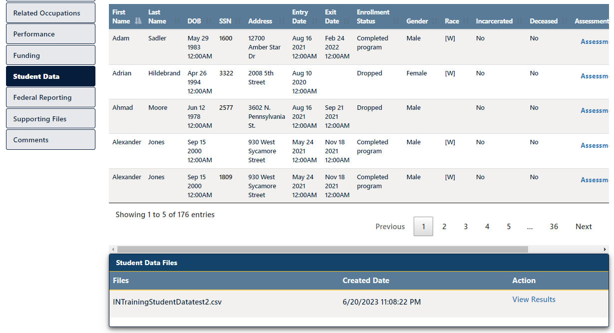
Three Reporting Methods - #3
Three Reporting Methods
18
Method 3: Student File Upload
After the provider successfully uploads the student data file, the provider can confirm the file was accepted by locating it within the ‘Student Data Files’ table.
Providers are encouraged to select ‘View Results’ under the ‘Action’ column to review/confirm all data fields were accurately completed.

Slide 19
Three Reporting Methods - #3
Three Reporting Methods
19
Method 3: Student File Upload
After the provider has successfully uploaded the student data file, the provider can navigate to the “Federal Reporting” tab, to conduct a final review of all submitted records. At the bottom of the tab, the provider will review and check the box certifying that the report is true and accurate, and then click “Submit Federal Reporting”.
Scroll to the bottom to certify and submit the report.

Slide 20
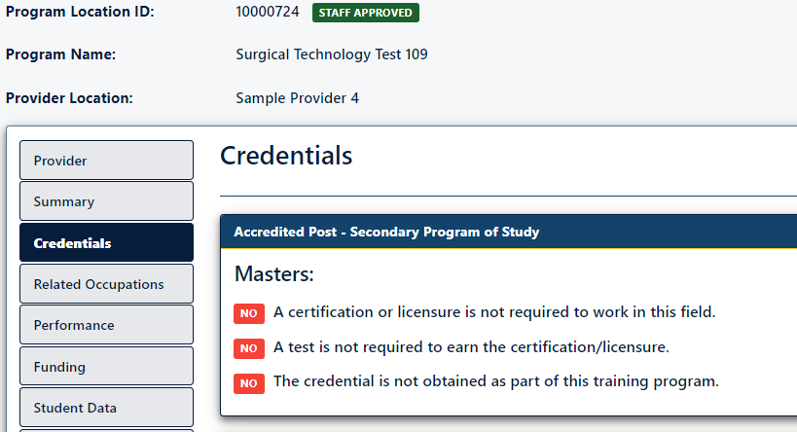
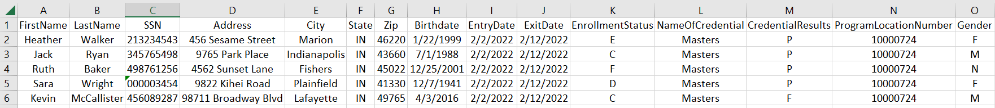
Troubleshooting Data Entry Errors
Troubleshooting Data Entry Errors
20
If the provider is utilizing the student data file upload option, ensure all information is added to the file with careful adherence to the guidance of the included instruction sheet.
Common errors occur when the provider has not included the correct program location ID, or the credential name does not match. Also, ensure there are no extra characters (like colon) or spaces entered within any data cell of the workbook.

Slide 21
Troubleshooting Data Entry Errors
Troubleshooting Data Entry Errors
21
If the provider is utilizing the student data file upload option, and if the program location includes two or more credentials, the provider must add an additional row for each student to account for the additional credentials (column L), along with the credential attainment results (column M).
Same student – multiple credentials attained within this program.

Slide 22
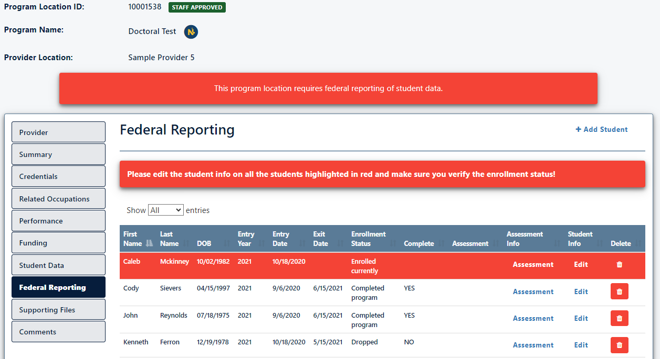
Troubleshooting Data Entry Errors
Troubleshooting Data Entry Errors
22
If one or more student records need updating, the record will be highlighted in red, within the Federal Reporting tab.
From this page, the provider may edit the student record to make enrollment stratus adjustments, or edit the assessment, to update the credential attainment result of the student record.
When all records no longer need attention, the provider will scroll to the bottom of the federal reporting tab to certify and submit the report.

Slide 23


Contact the INTraining Staff
23
Questions? We’re here to help.
If you have any federal reporting questions or concerns, our INTraining staff is eager to assist you.
Email us at INTraining@dwd.in.gov

